Slide 1
Medico-legal Issues
Version 1 – November 2022

Slide 2
Objectives
To understand the medico legal requirements and implications when undertaking adult critical care transfers.
To apply the medico legal requirements and implications in your practice when undertaking adult critical care transfers.
Version 1 – November 2022
Notes:
Transferring patients in an unfamiliar environment presents new challenges.
Decisions are made in an unfamiliar environment (out of hospital).
Risks and benefits must always be weighed up.
Patients, staff, transport, equipment are all open to scrutiny if any incident occurs.
Always work within your scope of practice.
Regulations/SOP’s/Policies affect your legal responsibilities during transfer.

Slide 3
Medico legal considerations
Mental capacity Act (2005).
Transfer responsibility (handover).
Patient/family wishes/consent.
Acceptance of transfer (referring and receiving hospital consultants must agree).
Timings of transfer. (Intensive Care Society, 2019)
Implications of transfer. (delayed transfer)
Appropriately qualified, trained and experienced staff (Intensive Care Society, 2019).
Use of drugs/controlled drugs.
Registration (NMC/GMC).
Version 1 – November 2022

Slide 4
Mental Capacity Act (2005)
Those who lack capacity have a lack of ability to:
1. Understand information
2. Assimilate information
3. Retain information
4. Unable to communicate needs
5. And: ‘have no appropriate friends/family/NOK to contact’.... (consider IMCA)
Failing one of the criteria declares incapacity.
If this is the case, act in the patients best interests at all times.
Consider IMCA.
Version 1 – November 2022

Slide 5
Implications of transfer – Beauchamp and Childress (1979)
Principle | Meaning
Beneficence | Doing good
Non-maleficence | Doing no harm
Justice | Fair treatment for all
Autonomy | Respect for patients wishes
All transfers must be based upon these principles.
These ethical considerations should always form part of your practice.
Not acting on these would be illegal and in breach of the MCA.
Version 1 – November 2022

Slide 6
Patients wishes
Obtain informed consent and clearly document.
Assent from NOK is courtesy.
Consent is a legal requirement from those with LPA.
All risks should be explained and documented.
Version 1 – November 2022

Slide 7
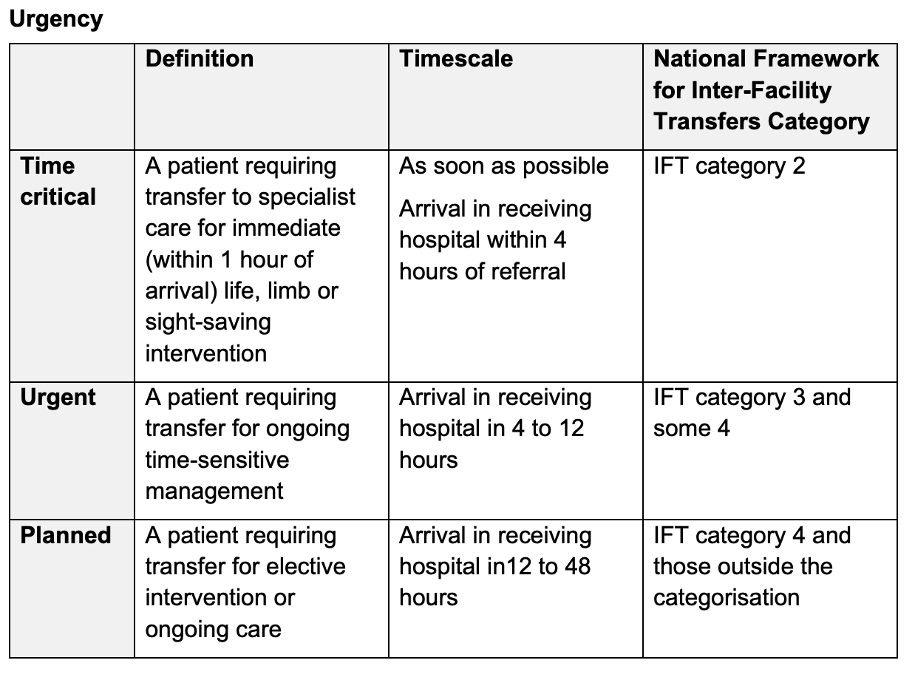
Acceptance/responsibility
The decision to transfer and to accept a patient must be made by appropriate consultants in both the referring and receiving hospitals (Intensive Care Society, 2019).
Transfer for immediate lifesaving interventions must not be delayed by lack of availability of a critical care bed (Intensive Care Society, 2019; NHS, 2021).
Refer a patient (ACCTS) – Inter-hospital transfers.
NHS, 2021
Version 1 – November 2022
Notes:
Once a patient has been accepted by a receiving unit, the bed must be kept available to receive the patient until the patient arrives or until the transfer is stood down (NHS, 2021).
Patients who require repatriation must be transferred within 48 hours of being identified as suitable for repatriation (Intensive Care Society, 2019).
Always work within your scope of practice, document diligently (NMC, 2015; GMC, 2020, HCPC 2020).
Retrieval teams (ACCTS) have responsibility once handover has occurred from referring hospital until handover has occurred at the receiving hospital (Intensive Care Society, 2019).
On arrival at the receiving hospital there should be a formal handover between the transfer team and the receiving medical and nursing staff. (HANDS OFF HANDOVER RECOMMENDED).
Once this has occurred, the receiving hospital have responsibility for the care of the patient and their relatives.

Slide 8
Ambulance Staff
Occasionally some transfer may occur with paramedics/emergency technicians and emergency care assistant be aware of their skills/experience.
STOP AND THINK!......
What are their responsibilities in: cardiac arrest/manual handling/safety/driving?
What training and experience have they had?
How do I communicate with them?...... Directions, limitations, patient condition, confidentiality?
Version 1 – November 2022

Slide 9
Safety of staff and patients
Seatbelts (regulation 6(1) – Road Traffic ACT, 1993).
Manual handling (local policy).
Infection control (local policy).
Training: competence, experience, qualifications.
Professional indemnity insurance (RCN/ICS).
Liability (local policy).
Version 1 – November 2022

Slide 10
Medication during transfer
In England, Scotland, Wales, companies need to apply for home office licenses if they wish to possess, import or export controlled drugs across international boundaries by road or air.
Controlled drugs are named in the misuse of drugs act (2014).
Document rate changes/doses commencement of drugs used during transfer.
Pre-drawn up medication, labelled and capped (Intensive Care Society, 2019).
Version 1 – November 2022

Slide 11
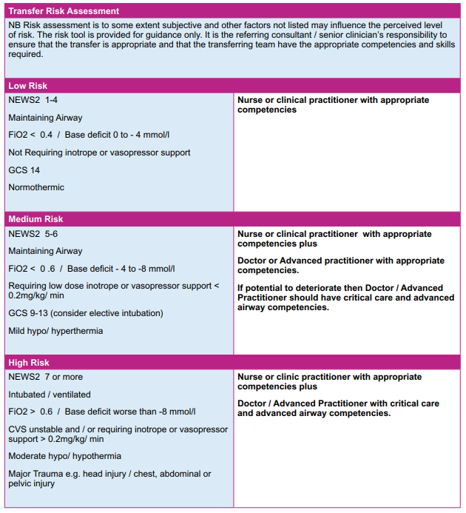
Transfer Risk assessment (ICS, 2019)
Version 1 – November 2022

Slide 12
Equipment
Equipment must be certificated for use (Low and Hulme, 2015).
Staff must be trained and certified to use equipment.
Equipment must be maintained and logged to the manufacturers schedule. Clear dates when it should not be used after.
Intensive Care Society Transfer guidelines, 2019.
Version 1 – November 2022

Slide 13
Intensive Care Society, 2019 – Transfer Guidelines
Recommendation:
‘Prior to the transfer of a critically ill patient, a risk assessment should be undertaken and documented by a senior clinician to determine the level of anticipated risk during transfer. The outcome of the risk assessment should be used to determine the competencies of the staff required to accompany the patient during transfer.’
Version 1 – November 2022

Slide 14
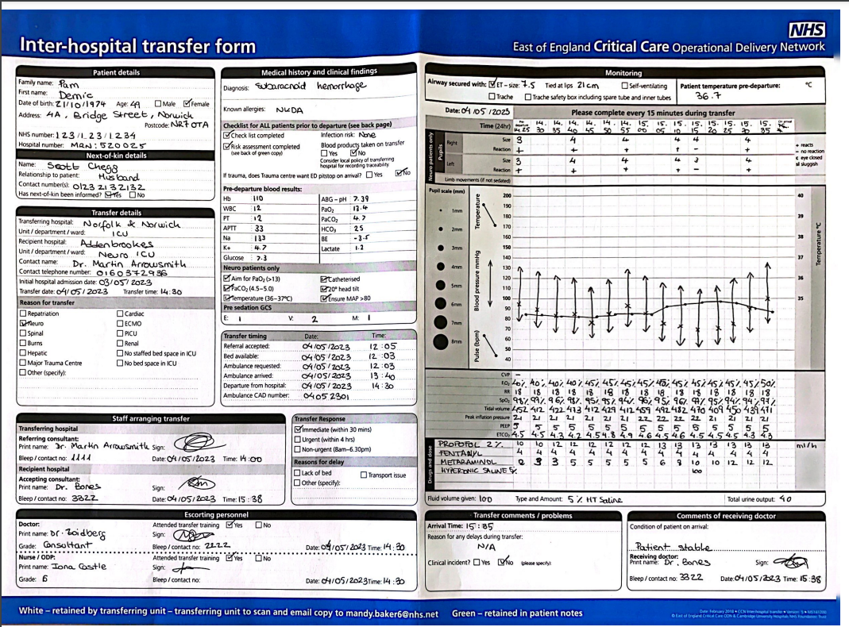
Documentation
Notes:
Key messages for documentation:
Transferring unit keeps blue form – scan and send to ……… Keep green in patient notes
Transfer timings – please keep a log of these – Times are audited
If there are delays – document this
On reverse side of transfer form: tick as appropriate pre-transfer checklist
When documenting observation – arrows are sufficient – however consider writing in systolic + diastolic +

Slide 15
Key messages
If it isn’t documented, it didn’t happen.
Utilise ACCTS – refer a patient.
Apply legal and ethical considerations.
Only undertake transfers if you have the right skills, experience and qualifications to do so.
Apply the Intensive Care Society Guidelines on transfers.
Version 1 – November 2022

Slide 16
References
Association of Ambulance Chief Executives. National Framework for Inter-facility transfers. 2018.
Evans, C, Creaton, A. and Kennedy, M., 2017. Retrieval Medicine. Oxford: Oxford Publishing Press.
Intensive Care Society, 2019. The Transfer of the Critically ill Adult. London: Intensive Care Society: London.
Kulshrestha, A. and Singh, J., 2016. Inter-hospital and Intra-Hospital patient transfer: Recent concepts. Indian Journal of Anaesthesia, 60(7), pp.451-457.
Low, A., and Hulme, J., 2015. ABC of Transfer and Retrieval Medicine. London: Wiley Blackwell.
Parmentier-Decrucq, E., Poissy, J., Favory, R., Nseir, S., Onimus, T. and Guerry, M.J., 2013. Adverse events during intrahospital transport of critically ill patients: Incidence and risk factors. Annual of Intensive Care, 3(10).
Venkategowda P. Rao S, Mutkule D, Taggu A, Unexpected events occurring during the intra-hospital transport of critically ill ICU patients. Indian Journal of Critical Care Medicine. 2014;18(6):354-7.
Mental Capacity Act, 2005. London: UK Government.
Road Traffic Act, 1993. London: UK Governernment.
NHS, 2021. https://www.england.nhs.uk/wp-content/uploads/2021/06/ACC-Transfer-Service-Toolkits.pdf.
Karger, S. and Basel, A.G., 2021. Principles of Clinical Ethics and Their Application to Practice, Medicine Clinical Practice, 30, pp.17-28.
Nursing and Council, 2015. NMC Standards of Practice, guidance for Nurses and Midwives. London: Nursing and Midwifery Council.
General Medical Council, 2019. Good Medical Practice. London: General Medical Council. https://www.gmc-uk.org/-/media/documents/good-medical-practice---english-20200128_pdf-51527435.pdf
Version 1 – November 2022

Slide 17
Questions?
Version 1 – November 2022

